Slide 1
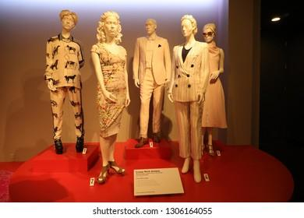
The Cute Corner Fashion & Design Institute
Agenda
  Goals
  Purpose
  The Future
  What I Need
Notes:
Include a cover slide that has the name of the organization, a logo (if available), and of course, your name.
Enlarge the image and/or provide more images. This is dull for a fashion institute. It should be vibrant and exciting.
Include the recorded narration.

Slide 2
Goals
Develop an academic background that nurtures professional and intellectual development of students
Establish and maintain a dedication to academic activities in creativity and research using technology
Provide quality certificate courses that give the required basics for the students’ career goals.
Notes:
Add some fashion images or someone working on a design.
Can you provide some of the certificate courses that would be offered?

Slide 3
Purpose
Providing opportunities to community students talented in fashion and design
Incorporating less privileged students in the society
Creating job opportunities for the residents
Producing locally trained fashion designers
Building community identity
Notes:
Who are the “community students?” What community, and what area?
What is meant by “Incorporating less privileged students in the society?”
- The remaining items are good but include who the residents are and from what community.

Slide 4
The future
This institute aims beyond offering fashion design courses
The institute aims at adding more courses including
  Leather design
  Textile design
  Beauty and cosmetics
The institute also aims at future expansion to offer diploma, bachelors, and masters courses.
Notes:
Provide the additional programs you are seeking to offer.
Institutes such as this may not be able to provide bachelors and masters courses, depending on their location and associated regulations.

Slide 5
What we Need
Funding for construction of the institute
Support in learning materials
Bursaries/scholarships for needy students
Funding to hire well qualified and experienced tutors
Notes:
How much funding is needed? You may not have an exact figure, but you should have a general idea.
What type of support in learning materials?
How many and what type of tutors are needed?

